Slide 1
Reading
and Math
at DSRF

Slide 2
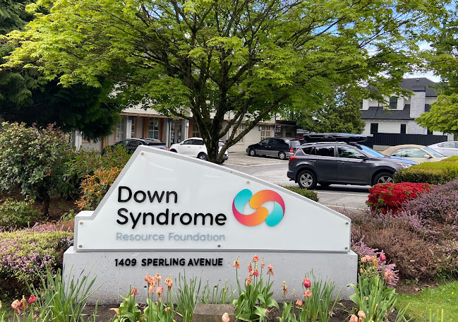
The Down Syndrome Resource Foundation has lots of programs and therapies.
Down Syndrome Resource Foundation | Reading and Math

Slide 3
A front desk assistant greets everyone coming into DSRF.
Down Syndrome Resource Foundation | Reading and Math

Slide 4
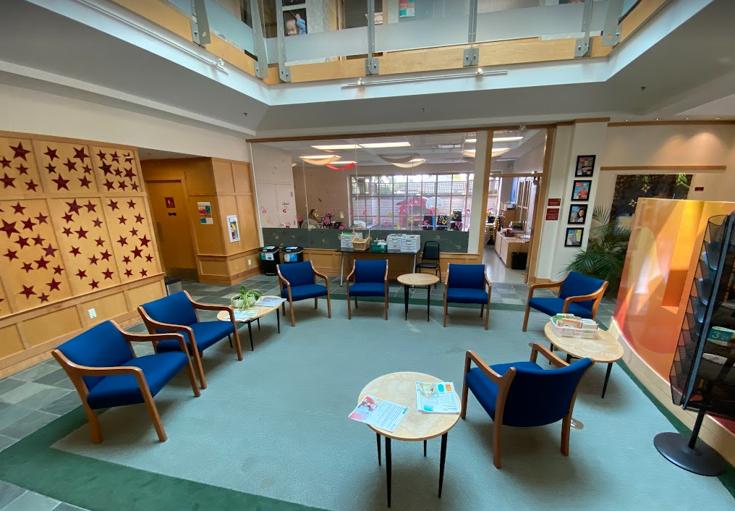
The lobby is where people wait for their teacher.
Down Syndrome Resource Foundation | Reading and Math

Slide 5
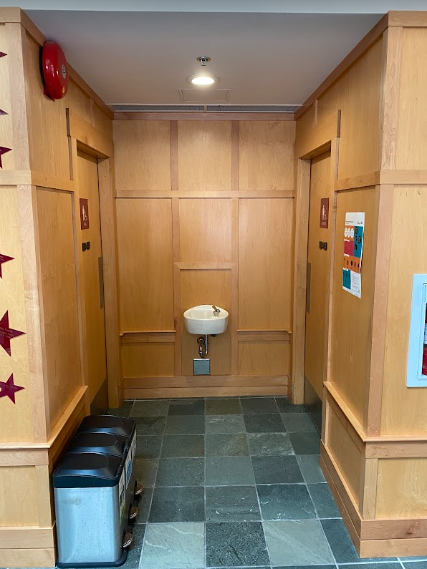
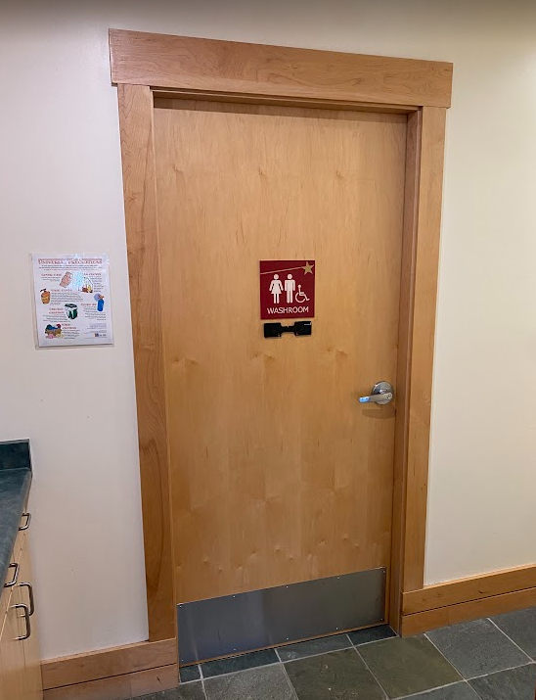
There are gendered washrooms and a large family washroom on the main floor.
Down Syndrome Resource Foundation | Reading and Math

Slide 6
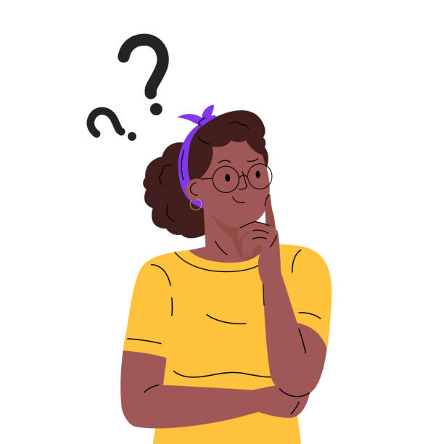
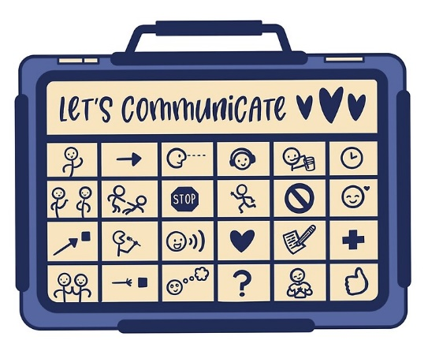
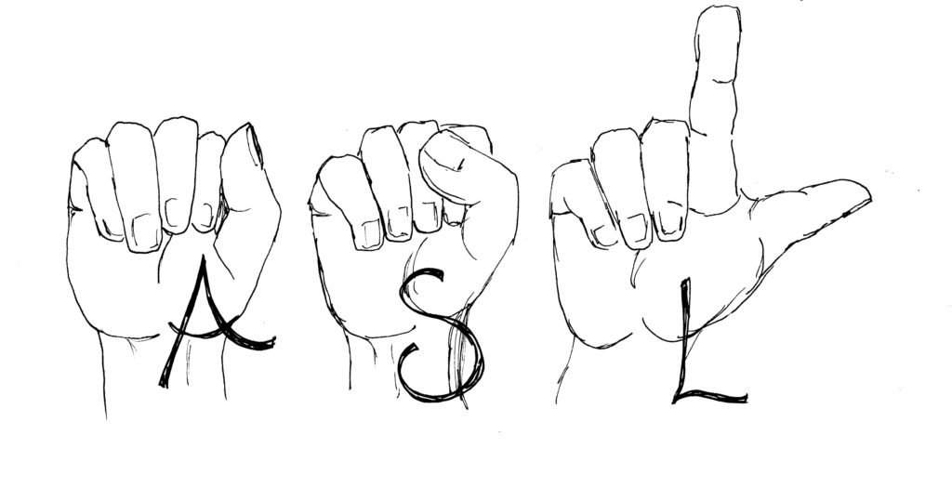
People who come to DSRF use all different kinds of communication. Curiosity is encouraged!
Down Syndrome Resource Foundation | Reading and Math

Slide 7
When it’s appointment time, clients will see their teacher.
Down Syndrome Resource Foundation | Reading and Math

Slide 8
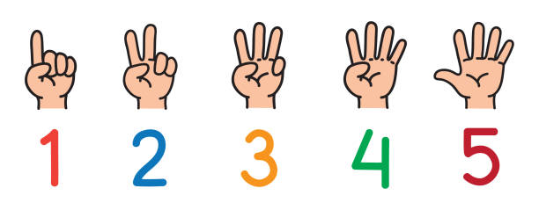
Reading and math sessions are 45 minutes.
Down Syndrome Resource Foundation | Reading and Math

Slide 9
Caregivers can sit in on teaching sessions, wait in the lobby, or leave and come back.
Down Syndrome Resource Foundation | Reading and Math

Slide 10
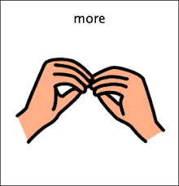
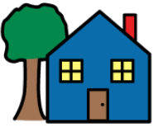
home
Clients might have more than one DSRF appointment. After seeing a teacher, it will either be time for a different session or time to go home.
Down Syndrome Resource Foundation | Reading and Math

