Slide 1



Speech Therapy
at DSRF

Slide 2

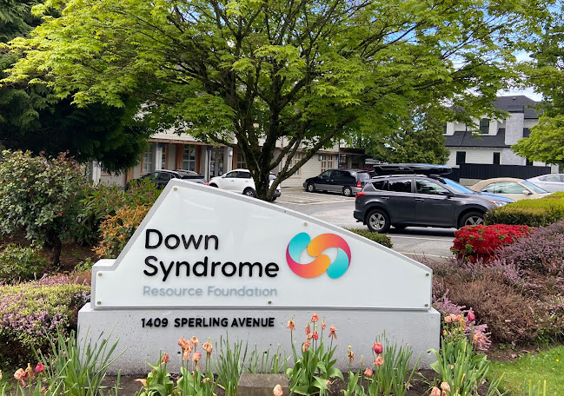
The Down Syndrome Resource Foundation has lots of programs and therapies.
Down Syndrome Resource Foundation | SLP

Slide 3

A front desk assistant greets everyone coming into DSRF.
Down Syndrome Resource Foundation | SLP

Slide 4


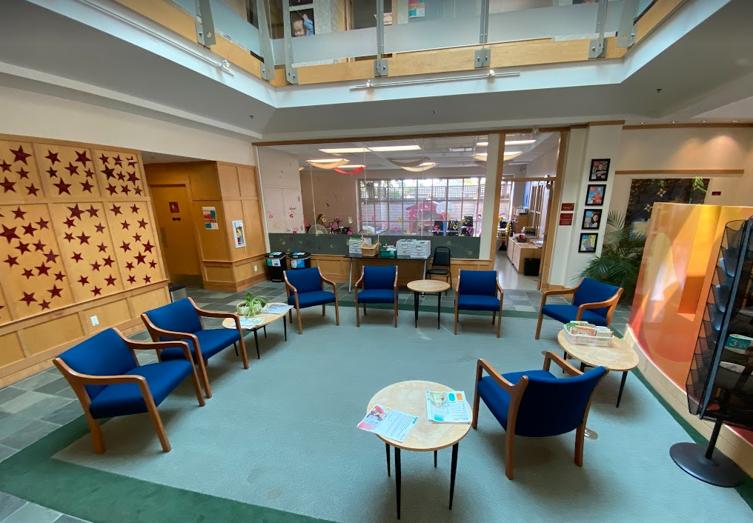
The lobby is where people wait for their speech therapist.
Down Syndrome Resource Foundation | SLP

Slide 5
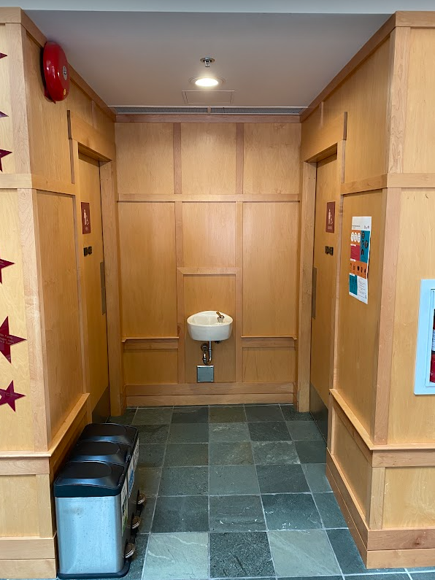
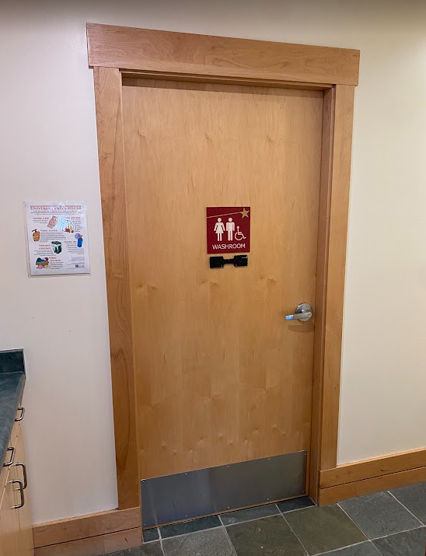
There are gendered washrooms and a large family washroom on the main floor.
Down Syndrome Resource Foundation | SLP

Slide 6
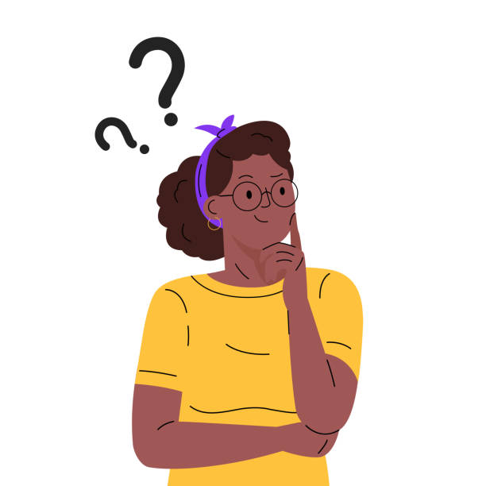
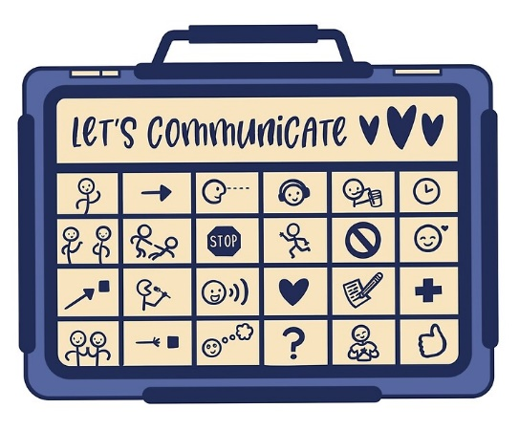
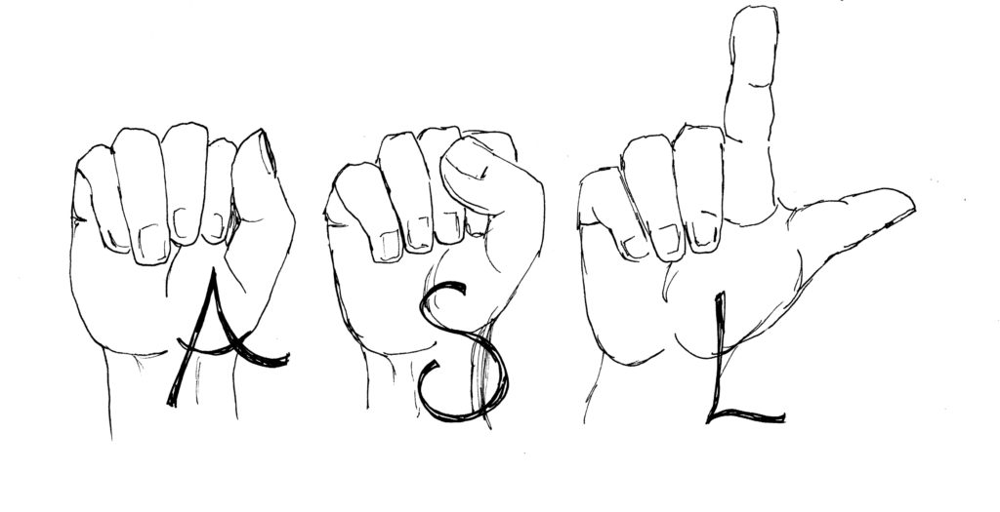
People who come to DSRF use all different kinds of communication. Curiosity is encouraged!
Down Syndrome Resource Foundation | SLP

Slide 7

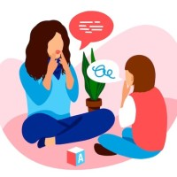
When it’s appointment time, clients will see their speech therapist.
Down Syndrome Resource Foundation | SLP

Slide 8
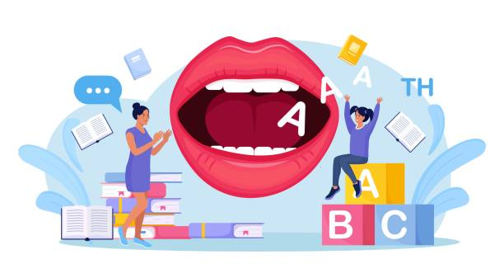

Speech therapy sessions are 45 minutes.
Down Syndrome Resource Foundation | SLP

Slide 9

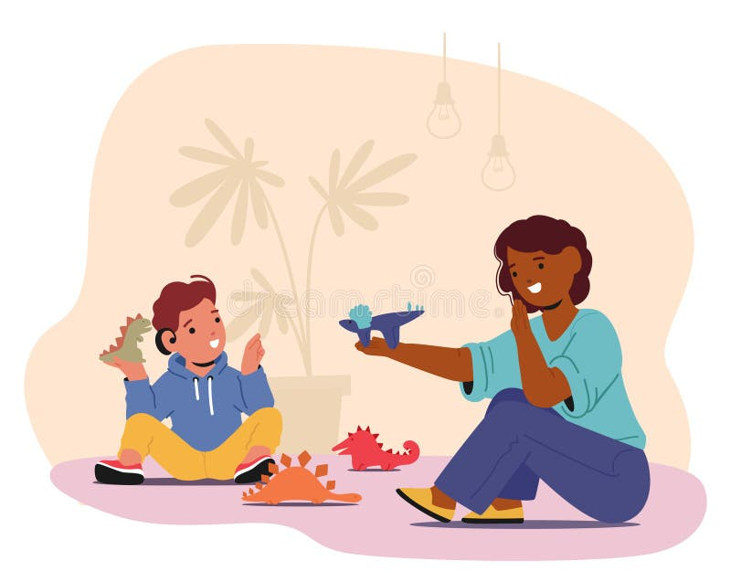
Caregivers can sit in on therapy sessions, wait in the lobby, or leave and come back.
Down Syndrome Resource Foundation | SLP

Slide 10
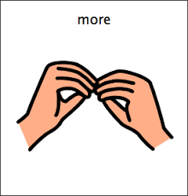
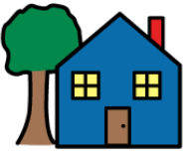

home
Clients might have more than one DSRF appointment. After speech therapy, it will either be time for a different session or time to go home.
Down Syndrome Resource Foundation | SLP

